Slide 1
Power BI Training Day 1 : Session 1 1 hour Power BI Introduction & Demo

Slide 2

Power BI Training Module 1 1 hour Power BI Introduction & Demo

Slide 3






Meet Your Presenter : David Moss MVP
Azure Advanced Analytics & Power BI Solutions
Delivering end to end BI solutions both on-premises & Azure with a passion for Power BI visualizations across IoT, e-commerce & manufacturing verticals.
MVP Data Platform
March 2017 awarded MVP for my community contributions. Co-leader of the London and Manchester Power BI User Group.
Power BI Global Advisory Board member.
@wottabyte
wottabyte
ACMA, CGMA Accountant
www.wottabyte.com
A qualified CGMA accountant all my career which keeps me commercially aware and able to work across the enterprise.

Slide 4

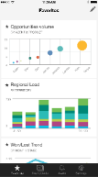
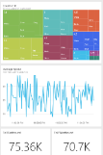
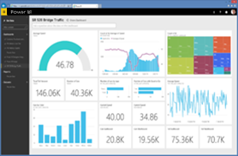
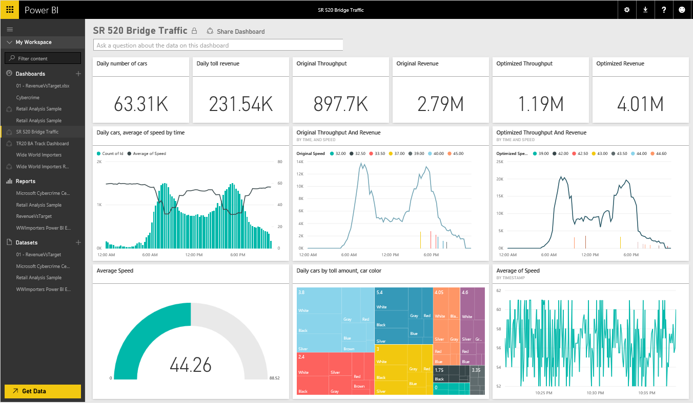
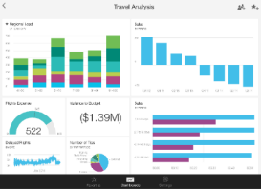
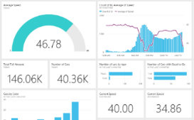
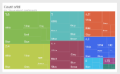

Introducing Microsoft Power BI
Experience your data. Any data, any way, anywhere.
Power BI is a cloud-based business analytics service
Power BI
Notes:
WHAT
What is Power BI ?
Key message:
Power BI is a business analytics service. With Power BI you can now see all of your data through a single pane of glass. Live Power BI dashboards and reports show visualizations and KPIs from data residing both on-premises and in the cloud, providing a consolidated view across your business regardless of where your data lives.
Talking points:
This is Power BI in a nutshell and the overall benefits to your business. We will look at what this means for the IT Pro and the key benefits for IT on the next slide

Slide 5
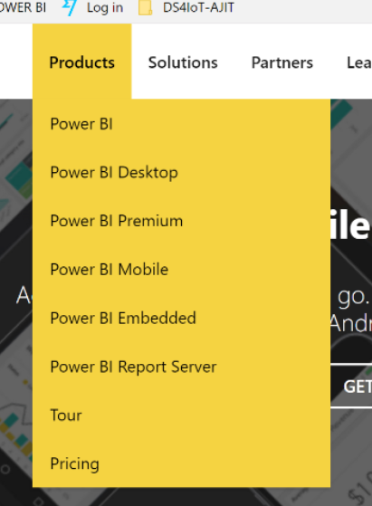
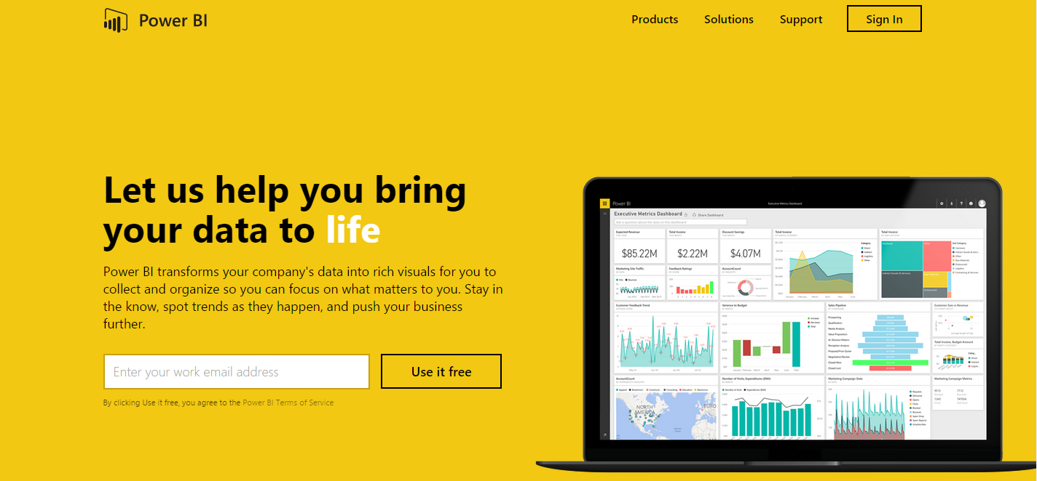
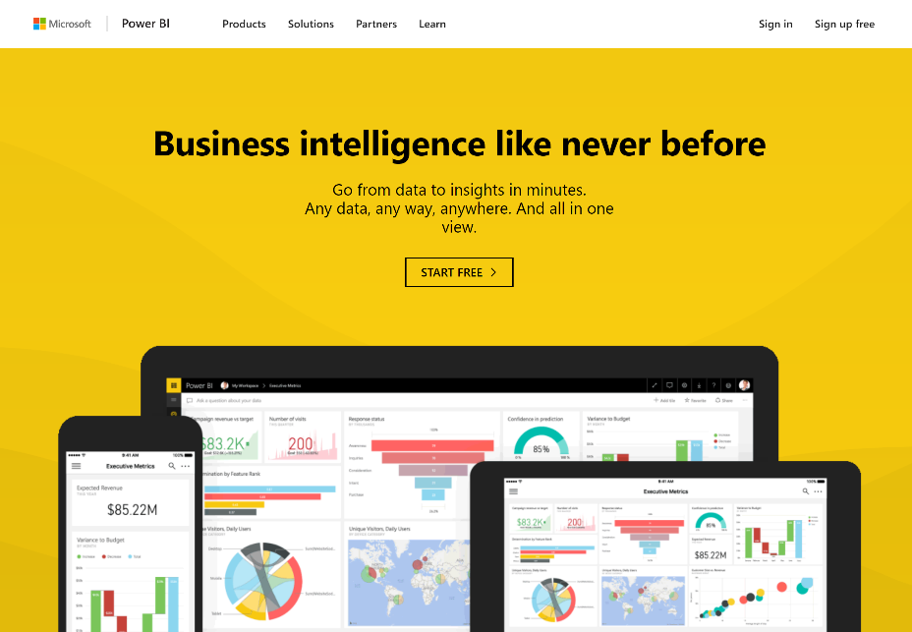
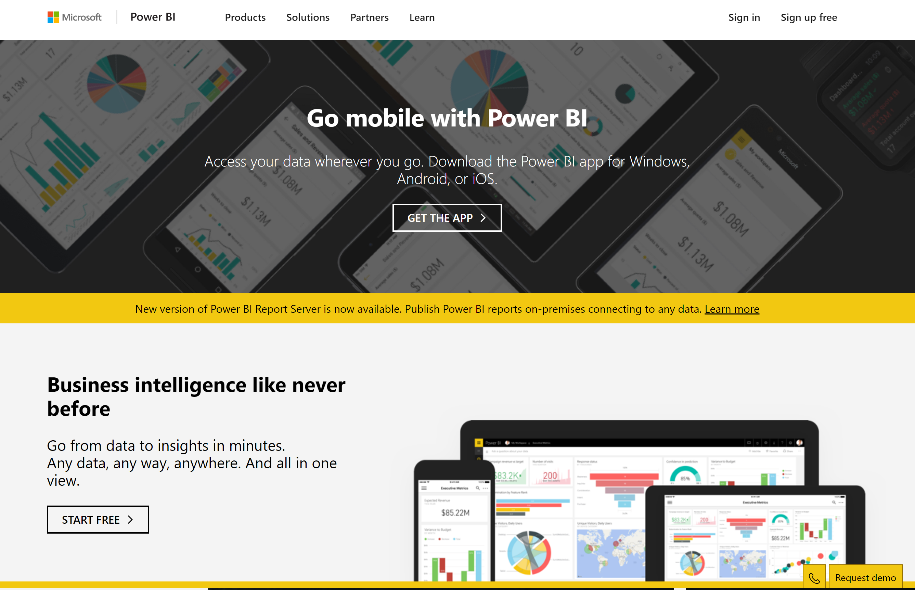

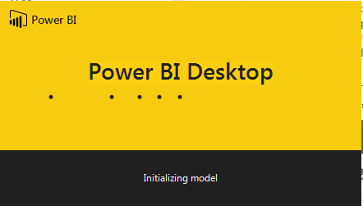
Get started now at www.powerbi.com
https://powerbi.Microsoft.com
https://app.powerbi.com
Notes:
WHERE
Lets see Power BI
1 Show powerbi.com (individual users can get data and build reports) Briefly.
2 Products : Power BI service / Power BI Desktop (developer) / Power BI Mobile / Power BI Embedded.
Power BI flow :
Publish to PowerBI.com / Create Dashboard : Share / End user consume dashboard & view reports / Data Refresh

Slide 6
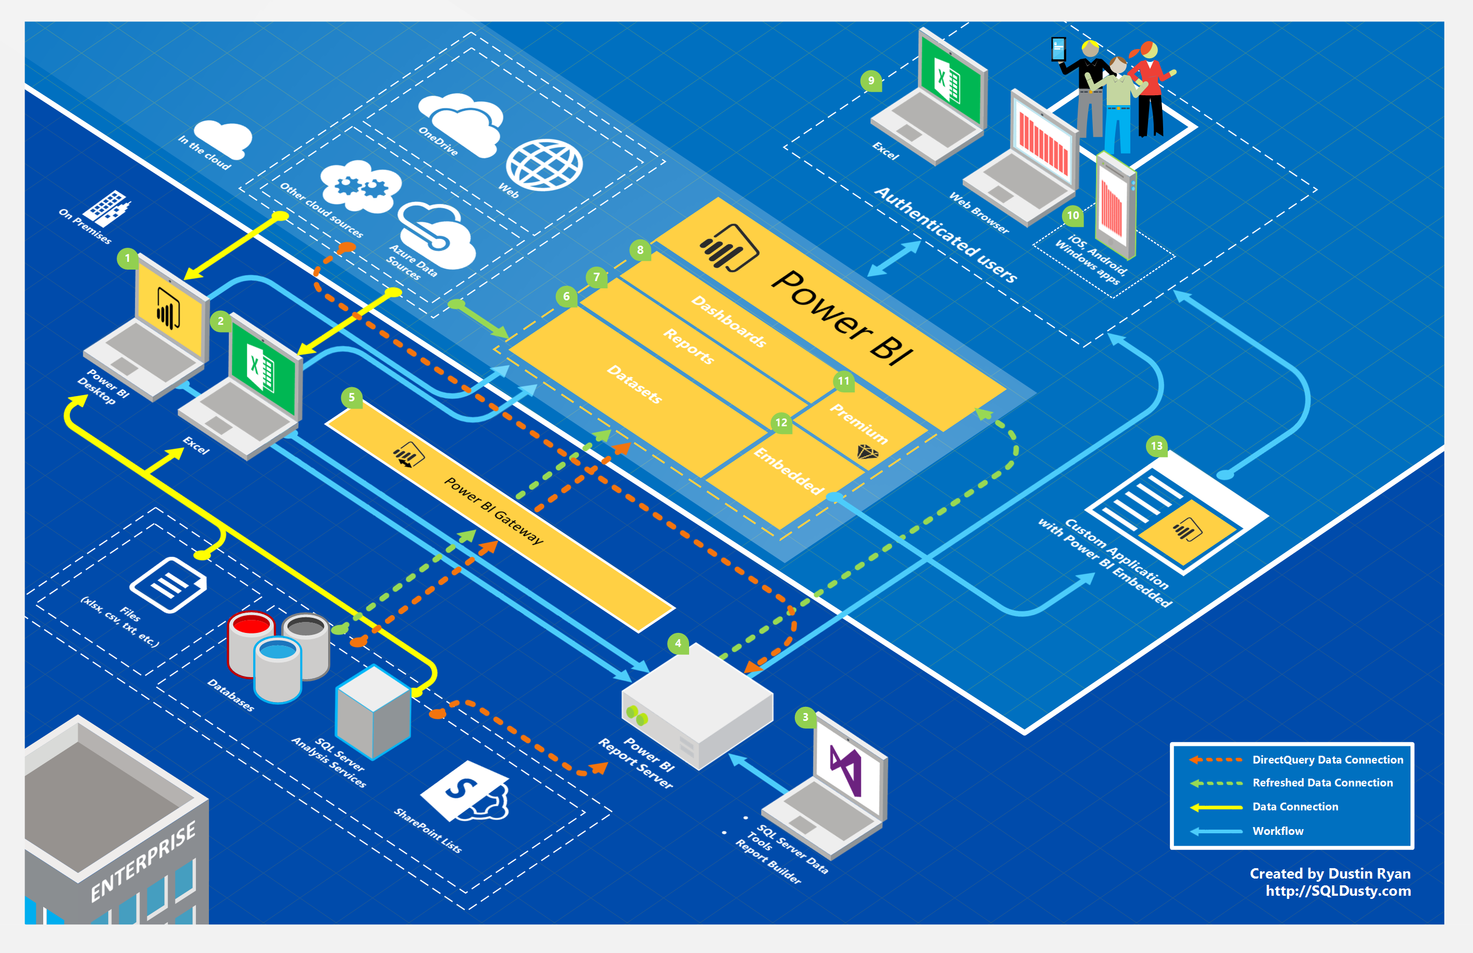
Notes:
HOW

Slide 7
Today, BI extends to everyone
3rd wave End user BI
Everyone
2nd wave Self-service BI
Analyst to end user
1st wave Technical BI
IT to end user
Notes:
Key message:
Business intelligence, or BI, has come a long way.
During the first two “waves” of business intelligence, IT professionals and business analysts were the keepers of BI. They made BI accessible and consumable for end users.
While this approach still applies to complex business intelligence needs, today there is a new “wave”.
This third wave of BI makes BI available to every kind of user.
Talking points:
Today we’re going to discuss Power BI, which is a third-wave solution. Power BI enables EVERYONE to collect, analyze, visualize and publish data.
This third-wave has the potential to expand the reach of analytics to more users than ever before. Existing analytics platforms and tools can be extended, instead of being replaced, by full-featured solutions like Power BI. Power BI directly connects to existing on-premises data, such as Analysis Services tabular models that were created by business analysts in collaboration with IT. Microsoft Excel and the new Power BI Desktop work hand-in-hand with Power BI, publishing reports and models created by business analysts and getting them more easily in the hands of the business users who can gain insight and take action.

Slide 8
Turning data into business insights is challenging
Common BI challenges include…
End-to-end view
Data often resides in disparate locations, making it difficult to see a complete picture of your business
Multiple data sources
Data residing in SaaS solutions and other external locations is difficult to access and refresh securely
Right data for the right users at the right time
Different roles have different needs and business users need the latest operational data
Notes:
Power BI addresses 3 common business intelligence challenges your organization may face:
Getting an end-to-end view off what is happening — because data is often in disparate locations, it can be difficult for business users to see a complete picture of your business
Managing multiple data sources — Data residing in SaaS solutions and other external locations can be difficult to manage programmatically, or access and refresh securely
Making the right data available to the right users at the right time
Mobile business users need the latest operational data at their fingertips, no matter where they are or what device they’re using
Different roles have different needs and access levels, so a one-size-fits all solution doesn’t work

Slide 9
Power BI
Experience your data. Any data, any way, anywhere
Power BI is a cloud-based business analytics service that enables
fast and easy access to your data
a live 360º view of your business
data discovery and exploration
insights from any device
collaboration across your organization
anyone to visualize and analyze data
Notes:
Key message:
Power BI is a business analytics service. With Power BI you can now see all of your data through a single pane of glass. Live Power BI dashboards and reports show visualizations and KPIs from data residing both on-premises and in the cloud, providing a consolidated view across your business regardless of where your data lives.
Talking points:
This is Power BI in a nutshell and the overall benefits to your business. We will look at what this means for the IT Pro and the key benefits for IT on the next slide

Slide 10


Key benefits and differentiators of Power BI
Pre-built dashboards and reports for popular SaaS solutions
Real-time dashboard updates
Secure, live connection to your data sources, on-premises and in the cloud
Intuitive data exploration using natural language query
Integrated with familiar Microsoft products and utilizes commitment for scale & availability in Azure
Fast deployment, hybrid configuration, secure, and integrated with existing IT systems.
Notes:
Key message:
There are several capabilities that differentiate Power BI from other offerings in the market.
Talking points:
Power BI is a cloud-based analytics service that provides faster time to insight. It is used for visualizing, exploring and extracting insights from data. It brings together data from diverse sources to deliver rich, comprehensive views of business operations.
What that means is, with Power BI, you can see all of your data through a single pane of glass, and create an analytics environment in minutes to monitor data and share reports. Live dashboards and reports show visualizations and KPIs from data that reside both on-premises and in the cloud, providing a consolidated view across your business regardless of where your data lives.
There are several capabilities that are unique to Power BI – these include:
Pre-built dashboards and reports for popular SaaS solutions such as Marketo, Salesforce, GitHub, ZenDesk, Dynamics CRM, and many others
Dashboards and visualizations that support real-time updates
Secure, live connection to on-premises data sources to drive insight across the entire range of organizational information (Analysis Services, Azure SQL Database, SQL Database Auditing, Azure SQL Data Warehouse)
Automated scheduled refresh to keep your Power BI data in sync with on premises data sources
Native mobile applications for keeping users connected on the go
Easy integration with other Microsoft offerings, from Excel to Azure services
Intuitive data exploration, which enables users to ask questions of their data in plain English
To summarize, Power BI is a SaaS offering that enables anyone to easily connect to their data, create live operational dashboards and explore data via interactive visualizations

Slide 11


Power BI Overview
Power BI
Data sources
Power BI service
SaaS solutions
e.g. Marketo, Salesforce, GitHub, Google analytics
Content packs
Natural language query
Sharing & collaboration
On-premises data
e.g. Analysis Services
Live dashboards
Organizational content packs Corporate data sources or external data services
Visualizations
Azure services
Azure SQL, Stream Analytics…
Reports
Excel files
Workbook data / data models
01001
10101
Power BI Desktop files
Data from files, databases, Azure, and other sources
Datasets
Data refresh
Notes:
Let’s walk through an overview of how Power BI works.
1. The Power BI service, sometimes referred to as powerbi.com, is what allows you to:
Create beautiful visualizations to tell compelling data stories
Build rich, live dashboards that turn BI into business insights
Create reports & datasets from which you can create visualizations and dashboards
Enjoy the benefits of up-to-date data with real-time, automatic and scheduled refreshes
Share dashboards easily with other people in your organization
Ask questions of data in plain English with Natural Language Query
Stay connected to your data all the time with mobile applications
2. Power BI connects to a variety of data sources. These range across both cloud and on-premises sources, and include:
A variety of popular SaaS solutions, such as Marketo, Salesforce, GitHub, Dynamics CRM, Zendesk, and several others
On-premises databases – Power BI offers live connectivity to SQL Server Analysis Services, which we’ll cover in more detail later. And using a gateway solution, Power BI can connect to other database solutions.
Organizational content packs– Publish and share organizational content packs, which consist of pre-built dashboards, reports, data models, embedded queries, and metadata
Other Azure services – Power BI integrates tightly with SQL Azure and Stream Analytics, and will be integrating closely with more Azure services over time
Power BI Desktop and Excel files – Excel workbooks can be directly connected to Power BI.com, or may be used with Power BI Desktop. Power BI Desktop is a companion application to the Power BI service – it is a desktop tool that supports data analysis and reporting. Like Excel files, Power BI Desktop files may be uploaded to the Power BI service.

Slide 12


Power BI Overview
Power BI
Data sources
Power BI service
SaaS solutions
e.g. Marketo, Salesforce, GitHub, Google analytics
Content packs
Natural language query
Sharing & collaboration
On-premises data
e.g. Analysis Services
Live dashboards
Organizational content packs Corporate data sources or external data services
Visualizations
Azure services
Azure SQL, Stream Analytics…
Excel files
Workbook data / data models
Reports
01001
10101
Power BI Desktop files
Data from files, databases, Azure, and other sources
Datasets
0110001
00010110
Data refresh
Power BI Desktop
Power BI REST APIs
Prepare
Explore
Report
Share
Notes:
There is more….
3. Power BI Desktop is a visual data exploration tool that enables you to analyze data and create stunning reports. With Power BI Desktop, you are able to:
Acquire and prepare data using extensive query capabilities
Manipulation and consolidation of multiple data sources is performed in Power BI Desktop – this enables Power BI service users to use data from multiple sources in a single report
Establish data structure, then transform and analyze data
Visualize and explore your data in new ways through a freeform drag-and-drop canvas
Author reports with a broad range of modern data visualizations
Publish beautiful, interactive reports directly to the Power BI service
Securely share reports through unique, curated content library approach
4. Finally, the Power BI REST API library allows you to customize nearly every aspect of Power BI, including connecting to custom data sources, enabling real-time data streaming from your data source to Power BI, and integrating other applications with Power BI

Slide 13

Power BI Overview
Power BI
Data sources
Power BI service
SaaS solutions
e.g. Marketo, Salesforce, GitHub, Google analytics
Workspaces & Apps
Natural language query
Sharing & collaboration
On-premises data
e.g. Analysis Services
Live dashboards
Organizational content packs Corporate data sources or external data services
Visualizations
Azure services
Azure SQL, Stream Analytics…
Excel files
Workbook data / data models
Reports
01001
10101
Power BI Desktop files
Data from files, databases, Azure, and other sources
Datasets
0110001
00010110
Data refresh
Power BI Desktop
Power BI REST APIs & Power BI Embedded
Prepare
Explore
Report
Share
Notes:
WORKFLOW
Start Bottom Left:
1) Data preparation…. Get data, then transform and model
2) Exploration: Free form data exploration, canvas experience.
3) Report … Create interactive reports
4) Share and collaborate with Power BI : (o365 next slide)
Power BI Desktop preparation
Publish to Power Bi service: Use tiles from reports to create dashboards
Share : Dashboards / Content packs
Data Refresh : Schedule
Business user : Report consumer : Can also enhance & share
Power BI REST API & Embedded.
is a visual data exploration tool that enables you to analyze data and create stunning reports. With Power BI Desktop, you are able to:
Acquire and prepare data using extensive query capabilities
Manipulation and consolidation of multiple data sources is performed in Power BI Desktop – this enables Power BI service users to use data from multiple sources in a single report
Establish data structure, then transform and analyze data
Visualize and explore your data in new ways through a freeform drag-and-drop canvas
Author reports with a broad range of modern data visualizations
Publish beautiful, interactive reports directly to powerbi.com
Securely share reports through unique, curated content library approach
4. Finally, the Power BI REST API library allows you to customize nearly every aspect of Power BI, including connecting to custom data sources, enabling real-time data streaming from your data source to Power BI, and integrating other applications with Power BI

Slide 14
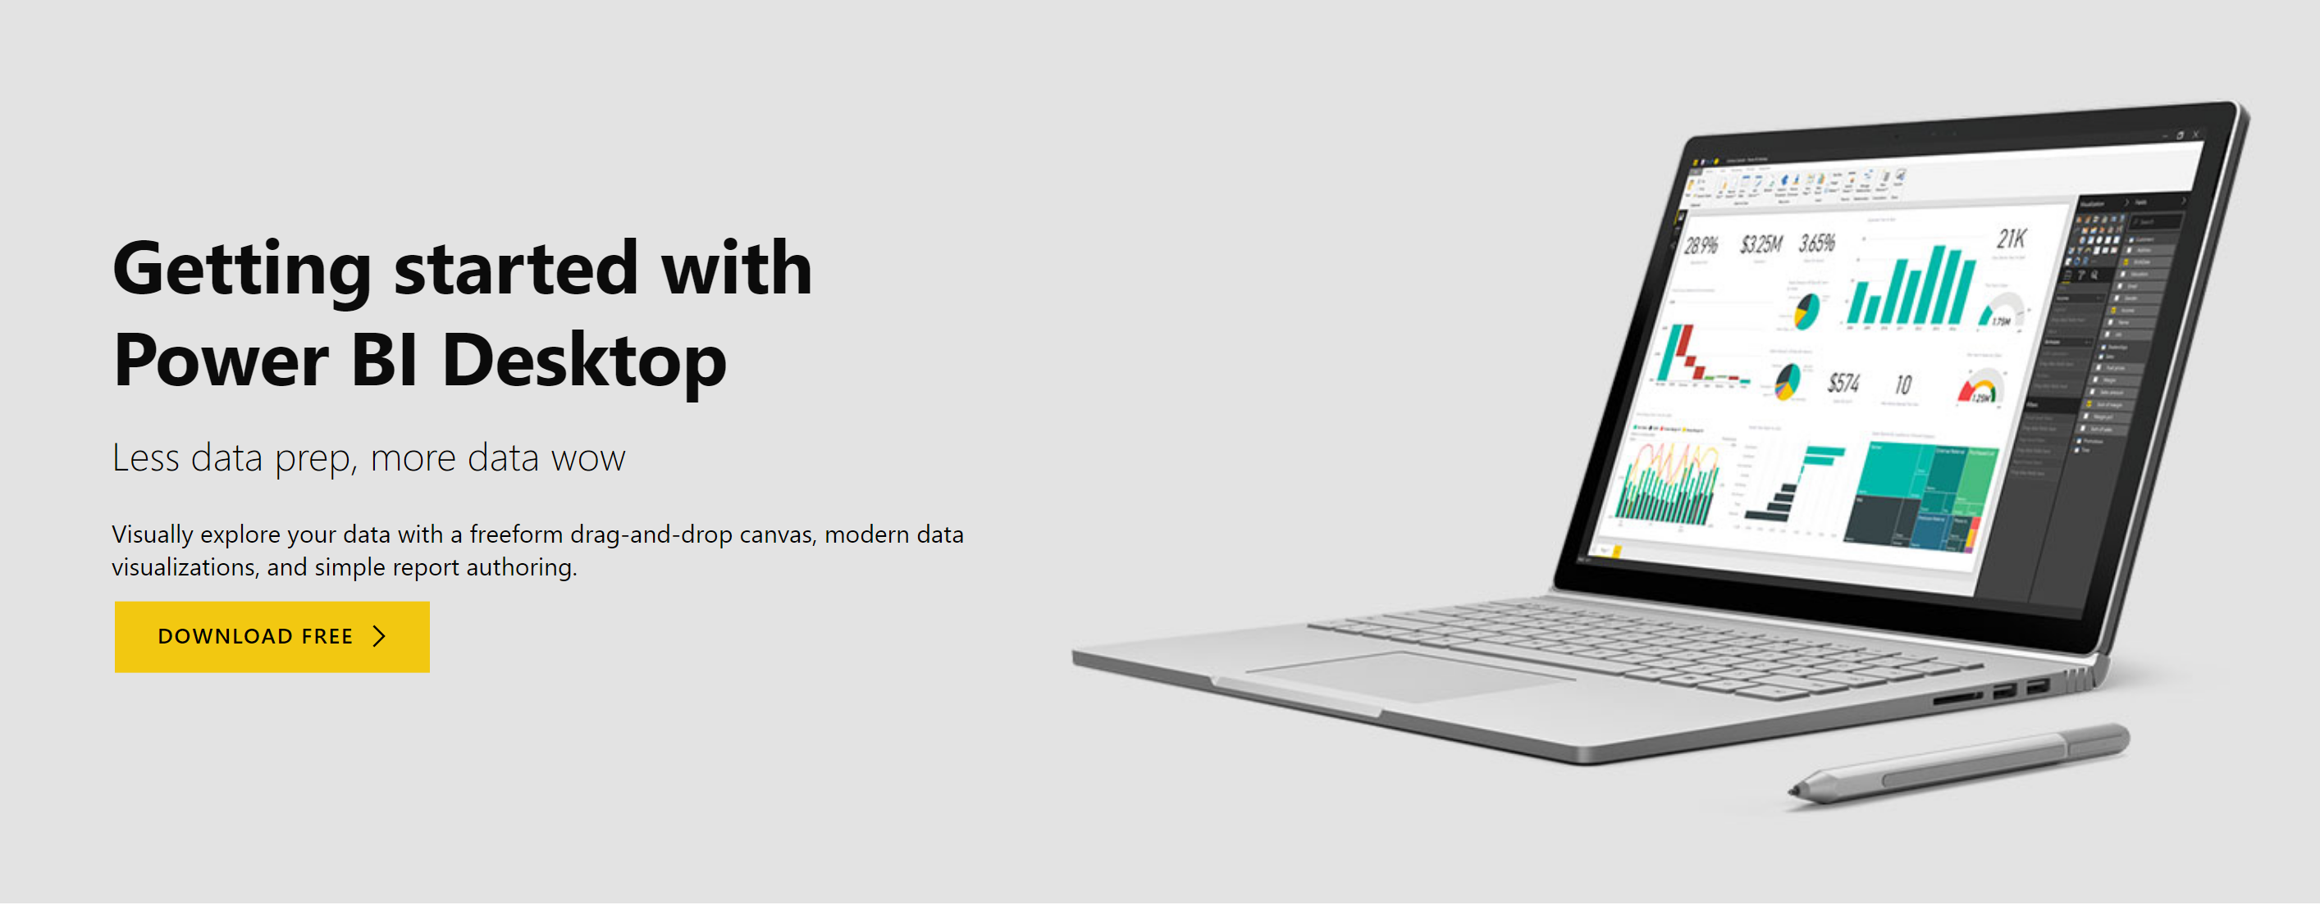

Slide 15
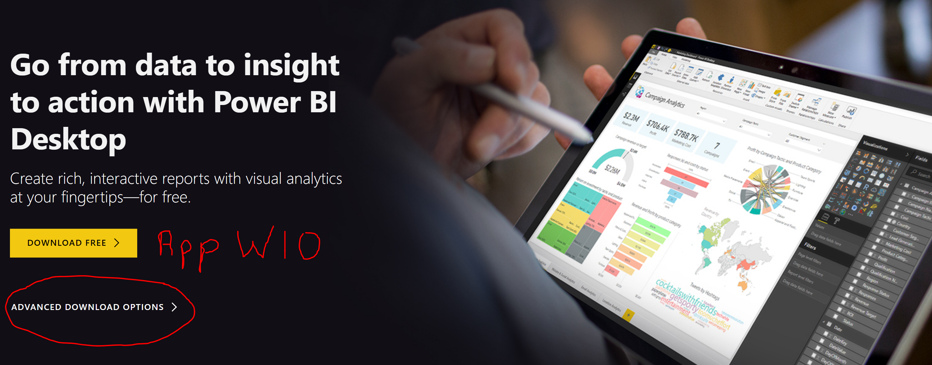
https://www.microsoft.com/en-us/download/details.aspx?id=45331

Slide 16
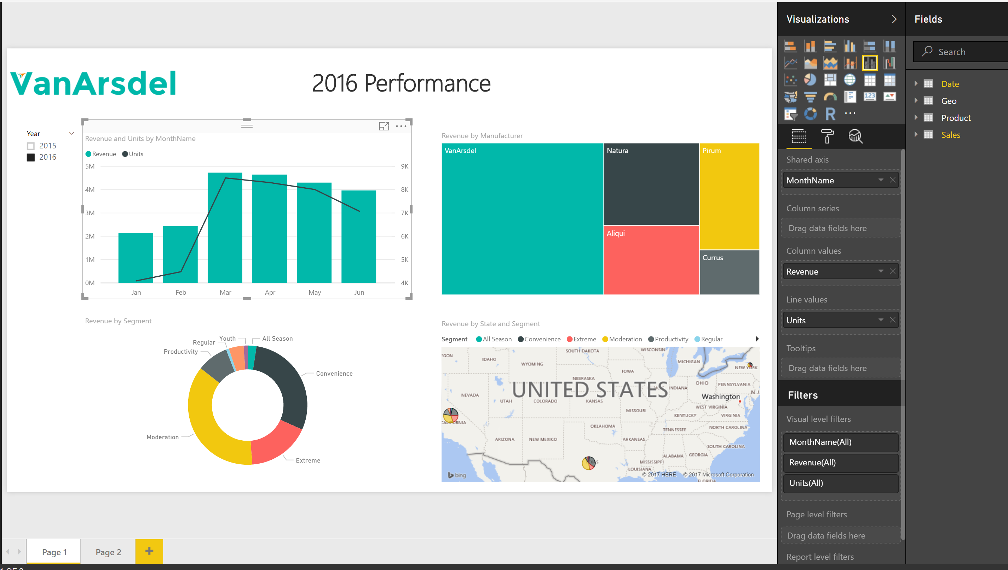
Switch to Power BI
David do live Introduction Demo
Notes:
A very short version of the DIAHour just to show full architecture and SIMPLE concepts and workflow.
Switch to Power BI Desktop and create Page1
Excel dataset
ETL
Datamodel
Reports
Publish
Dashboard
Share : email to all group

Slide 17
Power BI Training Day 1 : Session 1 1 hour Power BI Introduction END

